Slide 1
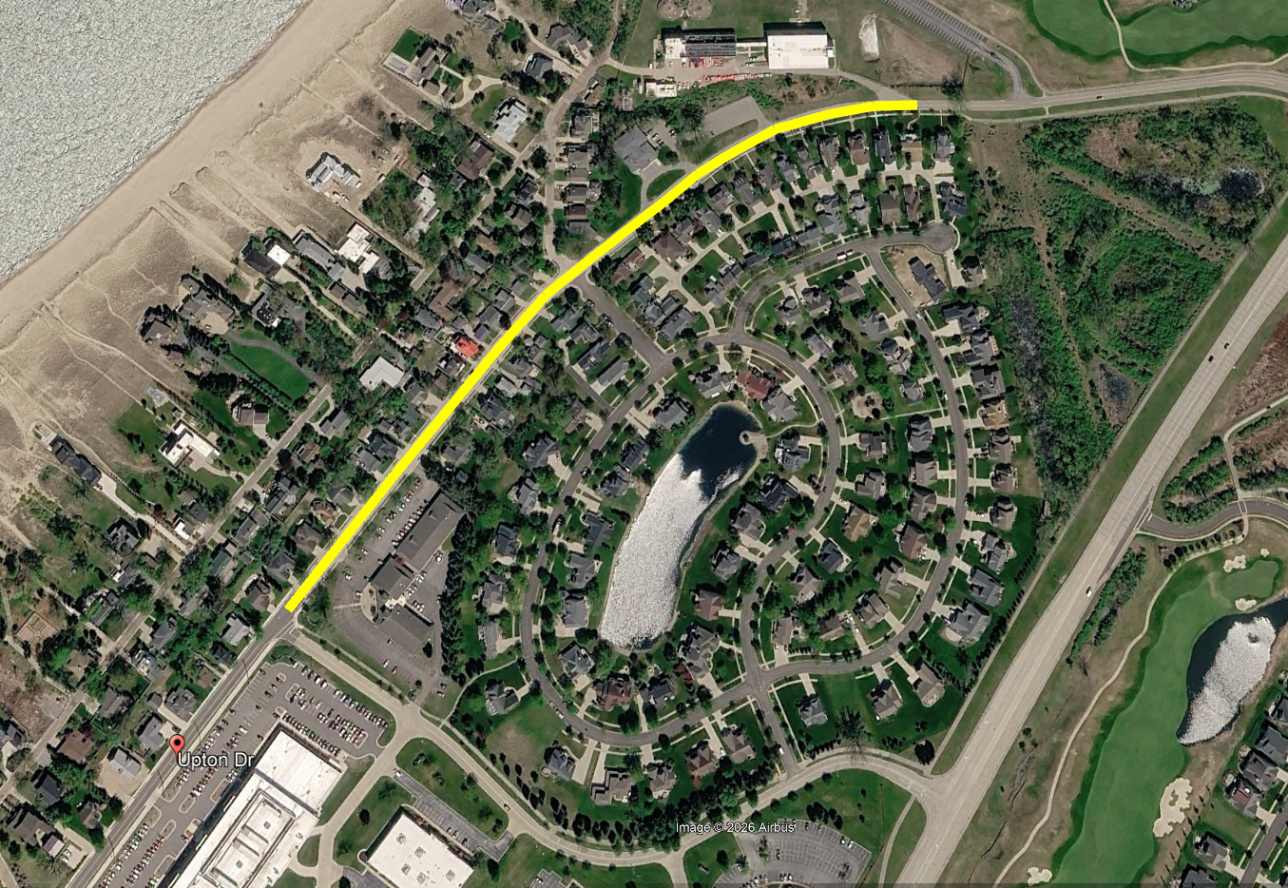
2028 Upton Drive Reconstruction Project
Non-Motorized Facilities Selection
Project Location Map
Klock Road
Upton Drive North
Edgewater Dunes Parkway
Upton Drive
Harry Gast Parkway (M63)
Momany Drive
Notes:
City staff is requesting approval of the type of non-motorized facility to install as with the 2028 Upton Drive Reconstruction Project, this evening.
You can see the project limits include Upton Drive from Momany Drive to the northern city limits.
One of the challenges on this project is the narrow right-of-way width on Upton from Momany Drive to the Edgewater Dunes Parkway-Upton Drive North intersection.

Slide 2
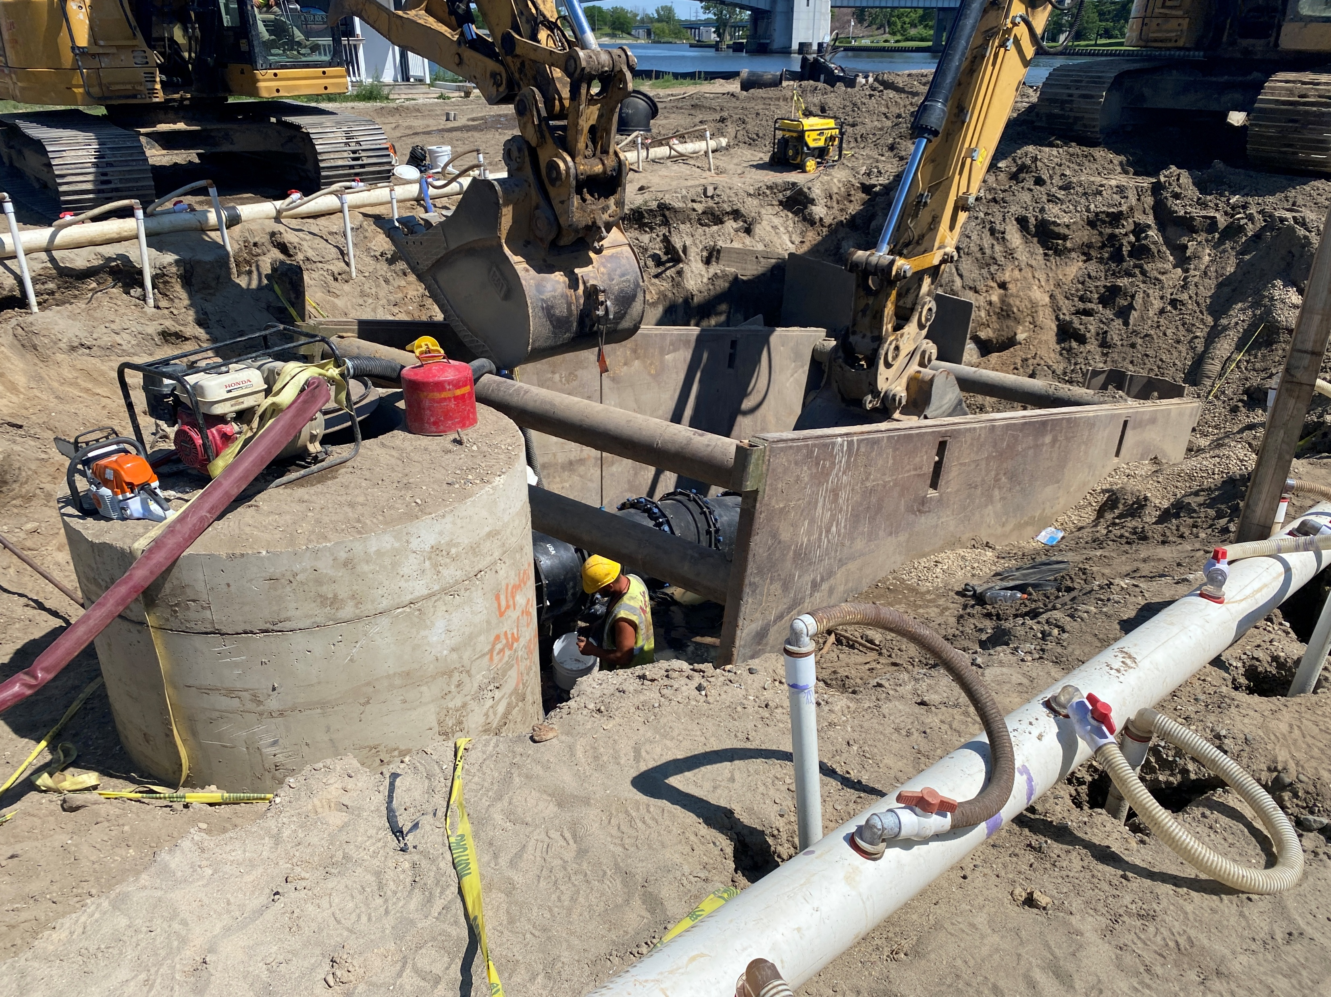
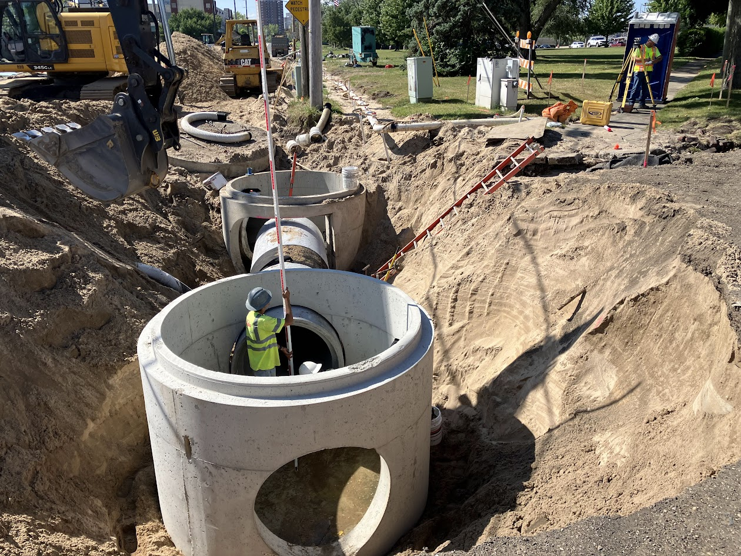
2028 Upton Drive Reconstruction Project
Non-Motorized Facilities Selection
Replace the roadway – Pavement Surface Evaluation and Rating (PASER) of 2 out of 10 = very poor condition.
Replace the Storm Sewer to improve drainage
Replace the Water Main
Replace Sanitary Sewer Services & Sanitary Manholes
ADA Improvements – Ramps and On-Street Parking
Install Non-Motorized Facilities – need a decision because AEP is replacing the transmission lines
Notes:
This is a typical City reconstruction project – read the slide.
There are two reasons the City should install non-motorized facilities on Upton Drive and they are (next slide):

Slide 3
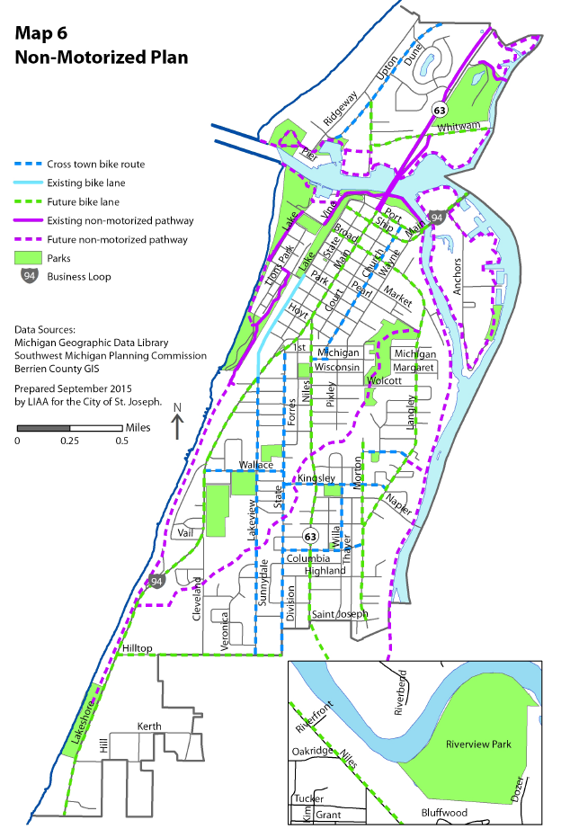
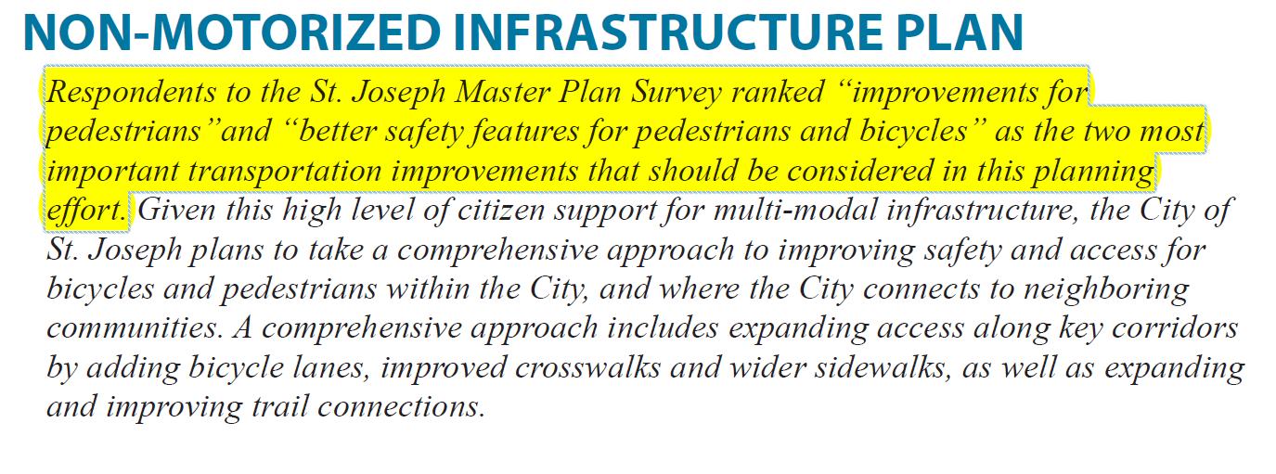
2028 Upton Drive Reconstruction Project
Non-Motorized Facilities Selection
Non-Motorized Facilities required by the Master Plan & to meet the complete streets policy
City Master Plan – Page 37
Notes:
The 2016 Master Plan places a high priority on pedestrian and bicycle safety and Upton Drive is designated a cross-town bike route on the map.

Slide 4
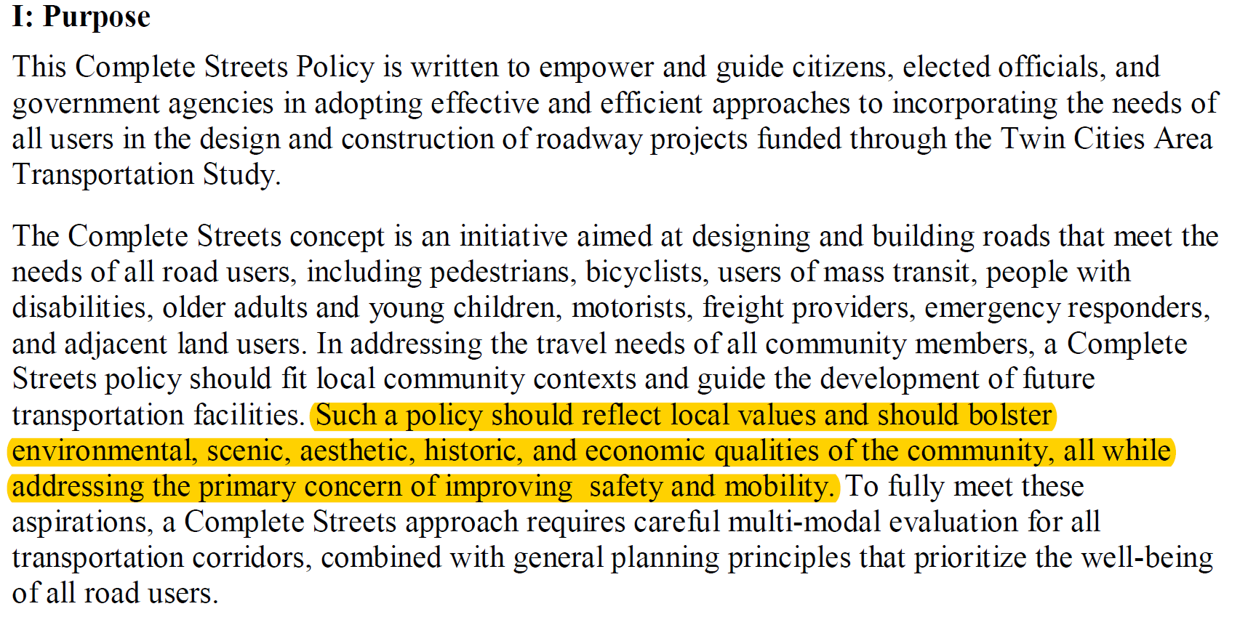
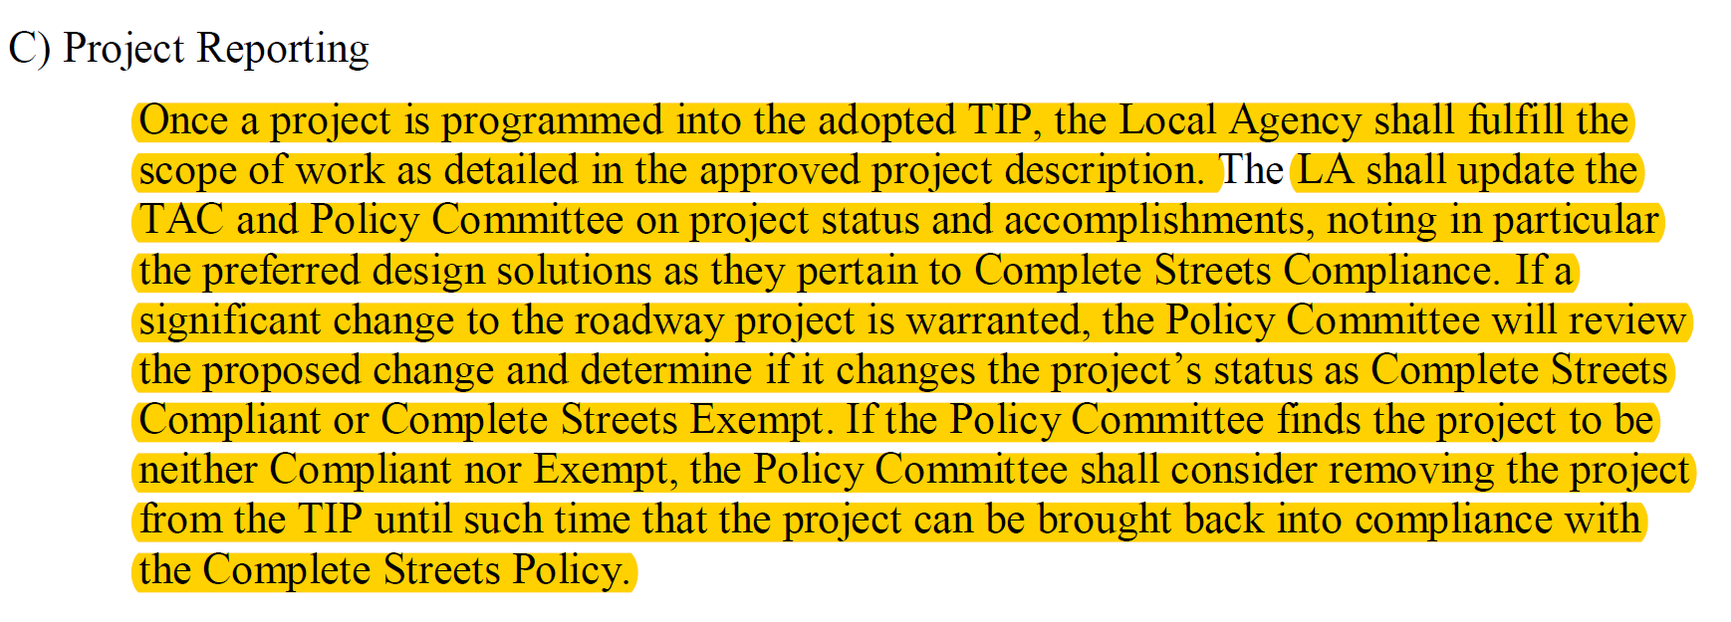
2028 Upton Drive Reconstruction Project
Non-Motorized Facilities Selection
Kingsley, Morton & Orchard and Langley Reconstruction Projects – Concept Selection
Excerpts from the Complete Streets Policy provided by the Southwest Michigan Planning Commission
The City will not be eligible for TIP (grant) funding if a non-motorized path or bike lanes are not included on future projects.
The 2028 Upton Drive Reconstruction Project is slated for $932,000 in Surface Transportation Block Grant (STBG) funding
Notes:
There are also funding implications.
Non-motorized facilities are required to meet the complete streets policy adopted by the Twin Cities Area Transportation Study in order to secure Surface Transportation Block Grant (STBG) funding.
In this case, the City is slated for approximately $932,000 STBG funding that will be lost if the plan does not include non motorized facilities.

Slide 5
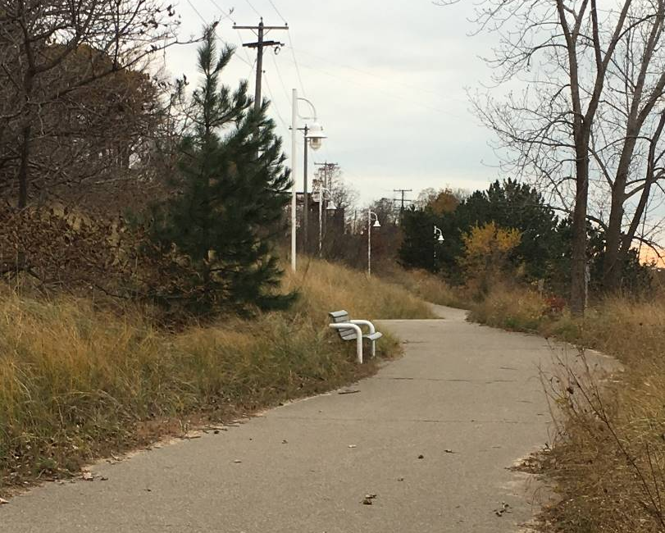
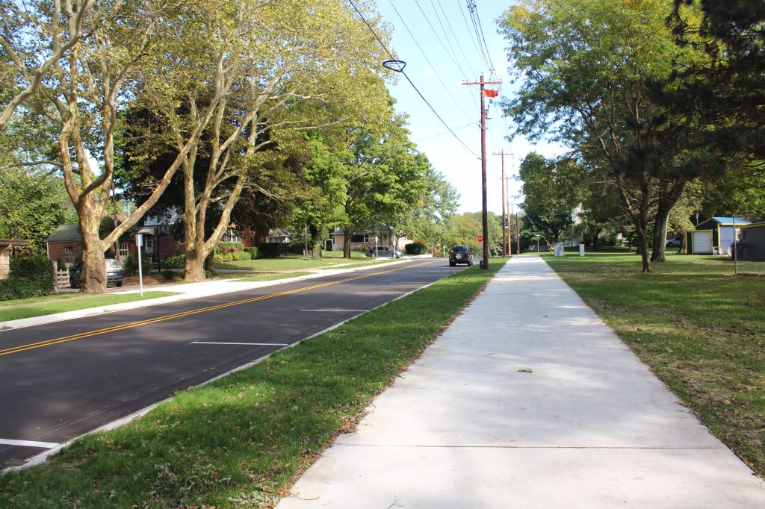
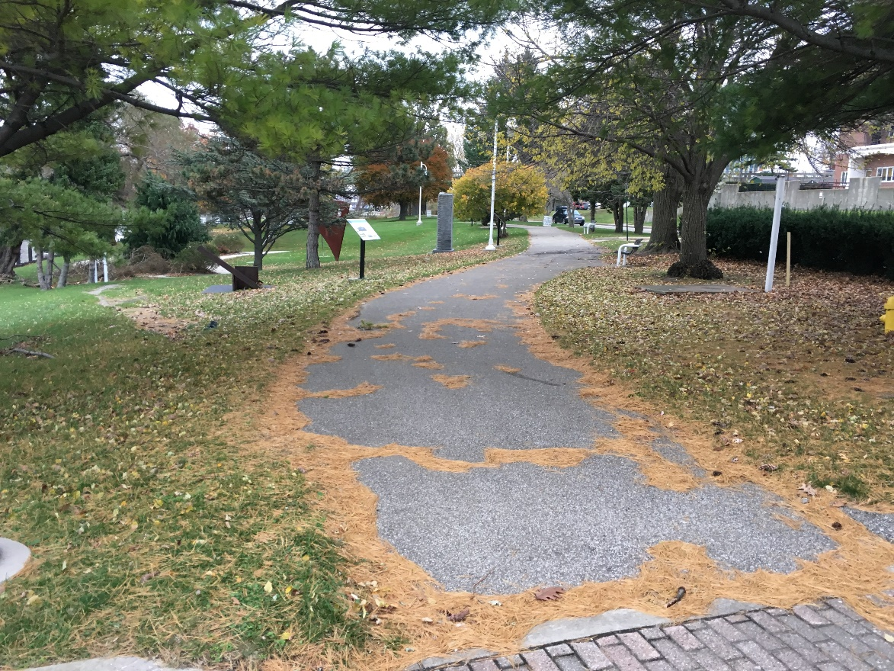
2028 Upton Drive Reconstruction Project
Non-Motorized Facilities Selection
Botham Avenue Reconstruction
Non-Motorized Facility Concept Selection
Wallace Ave
Lions Park Beach Area
Howard Family Trail
Examples of non-motorized
paths in the City
Margaret B. Upton Arboretum
Notes:
The concepts include two types of non-motorized facilities.
The above photos provide an example of non-motorized paths in the City.
The Wallace Avenue non-motorized path was installed in 2018 and was the first non-motorized facility to be built after the 2016 Master Plan was implemented.
The Howard Family Trail and Upton Arboretum paths are other examples.

Slide 6
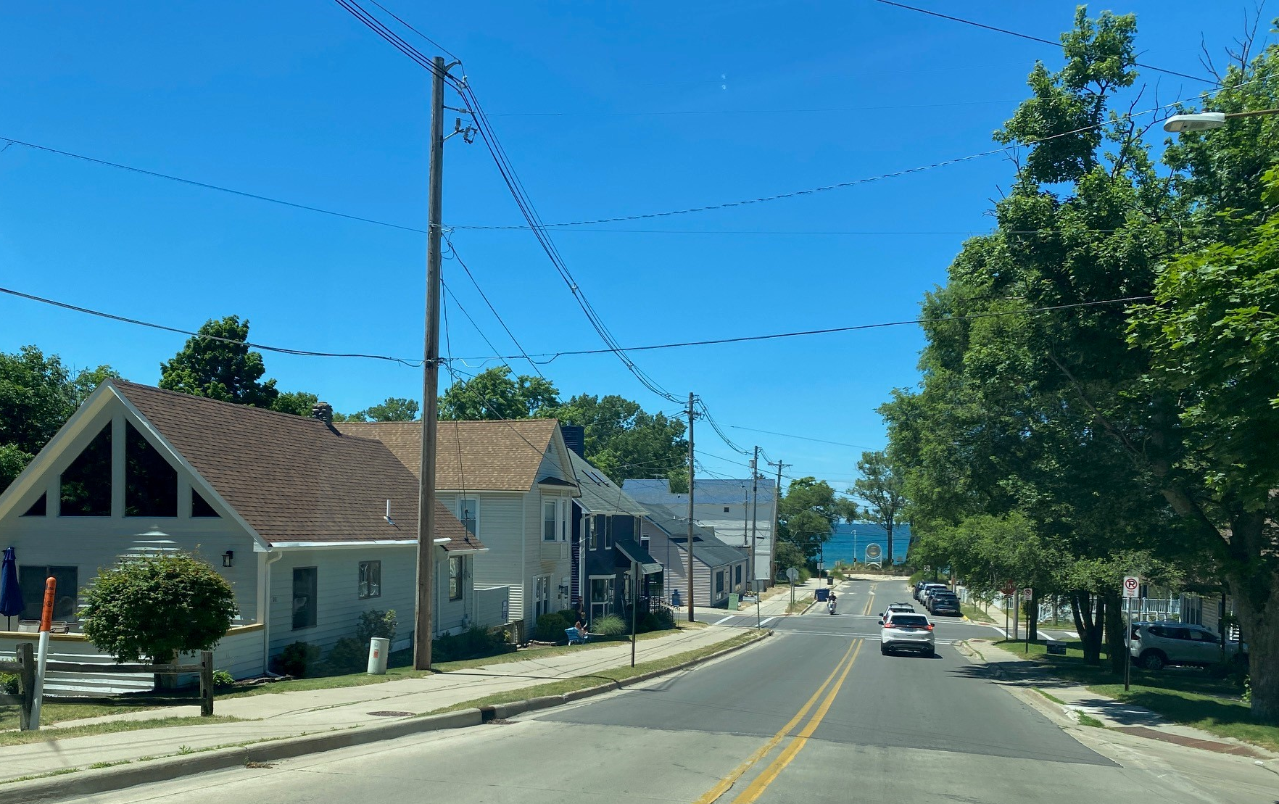
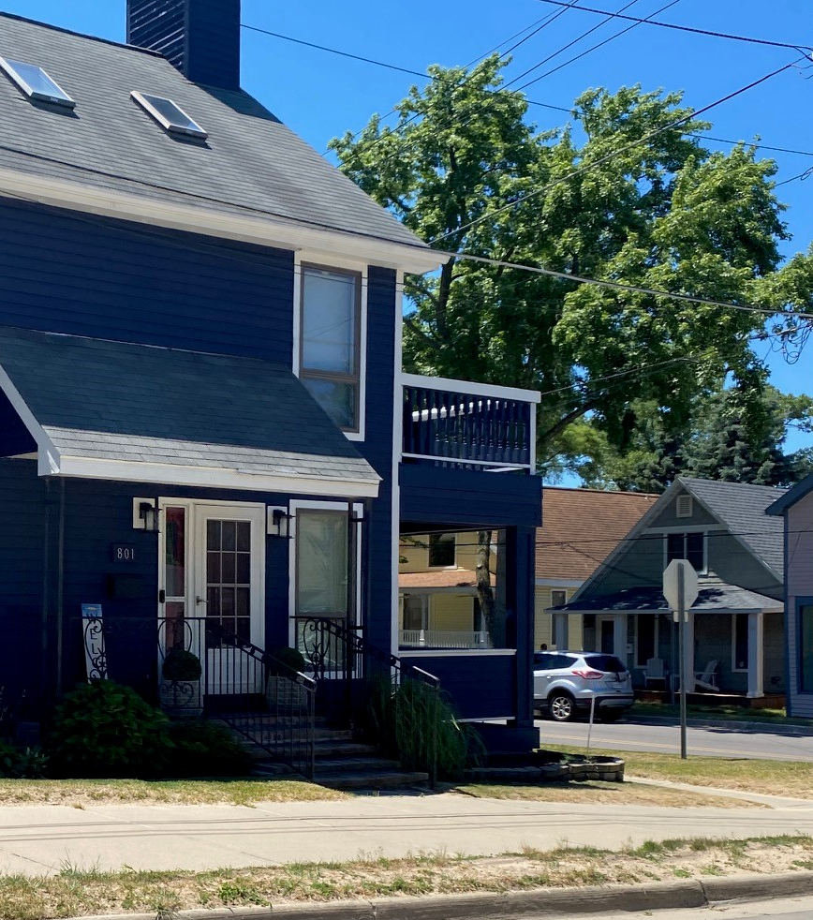
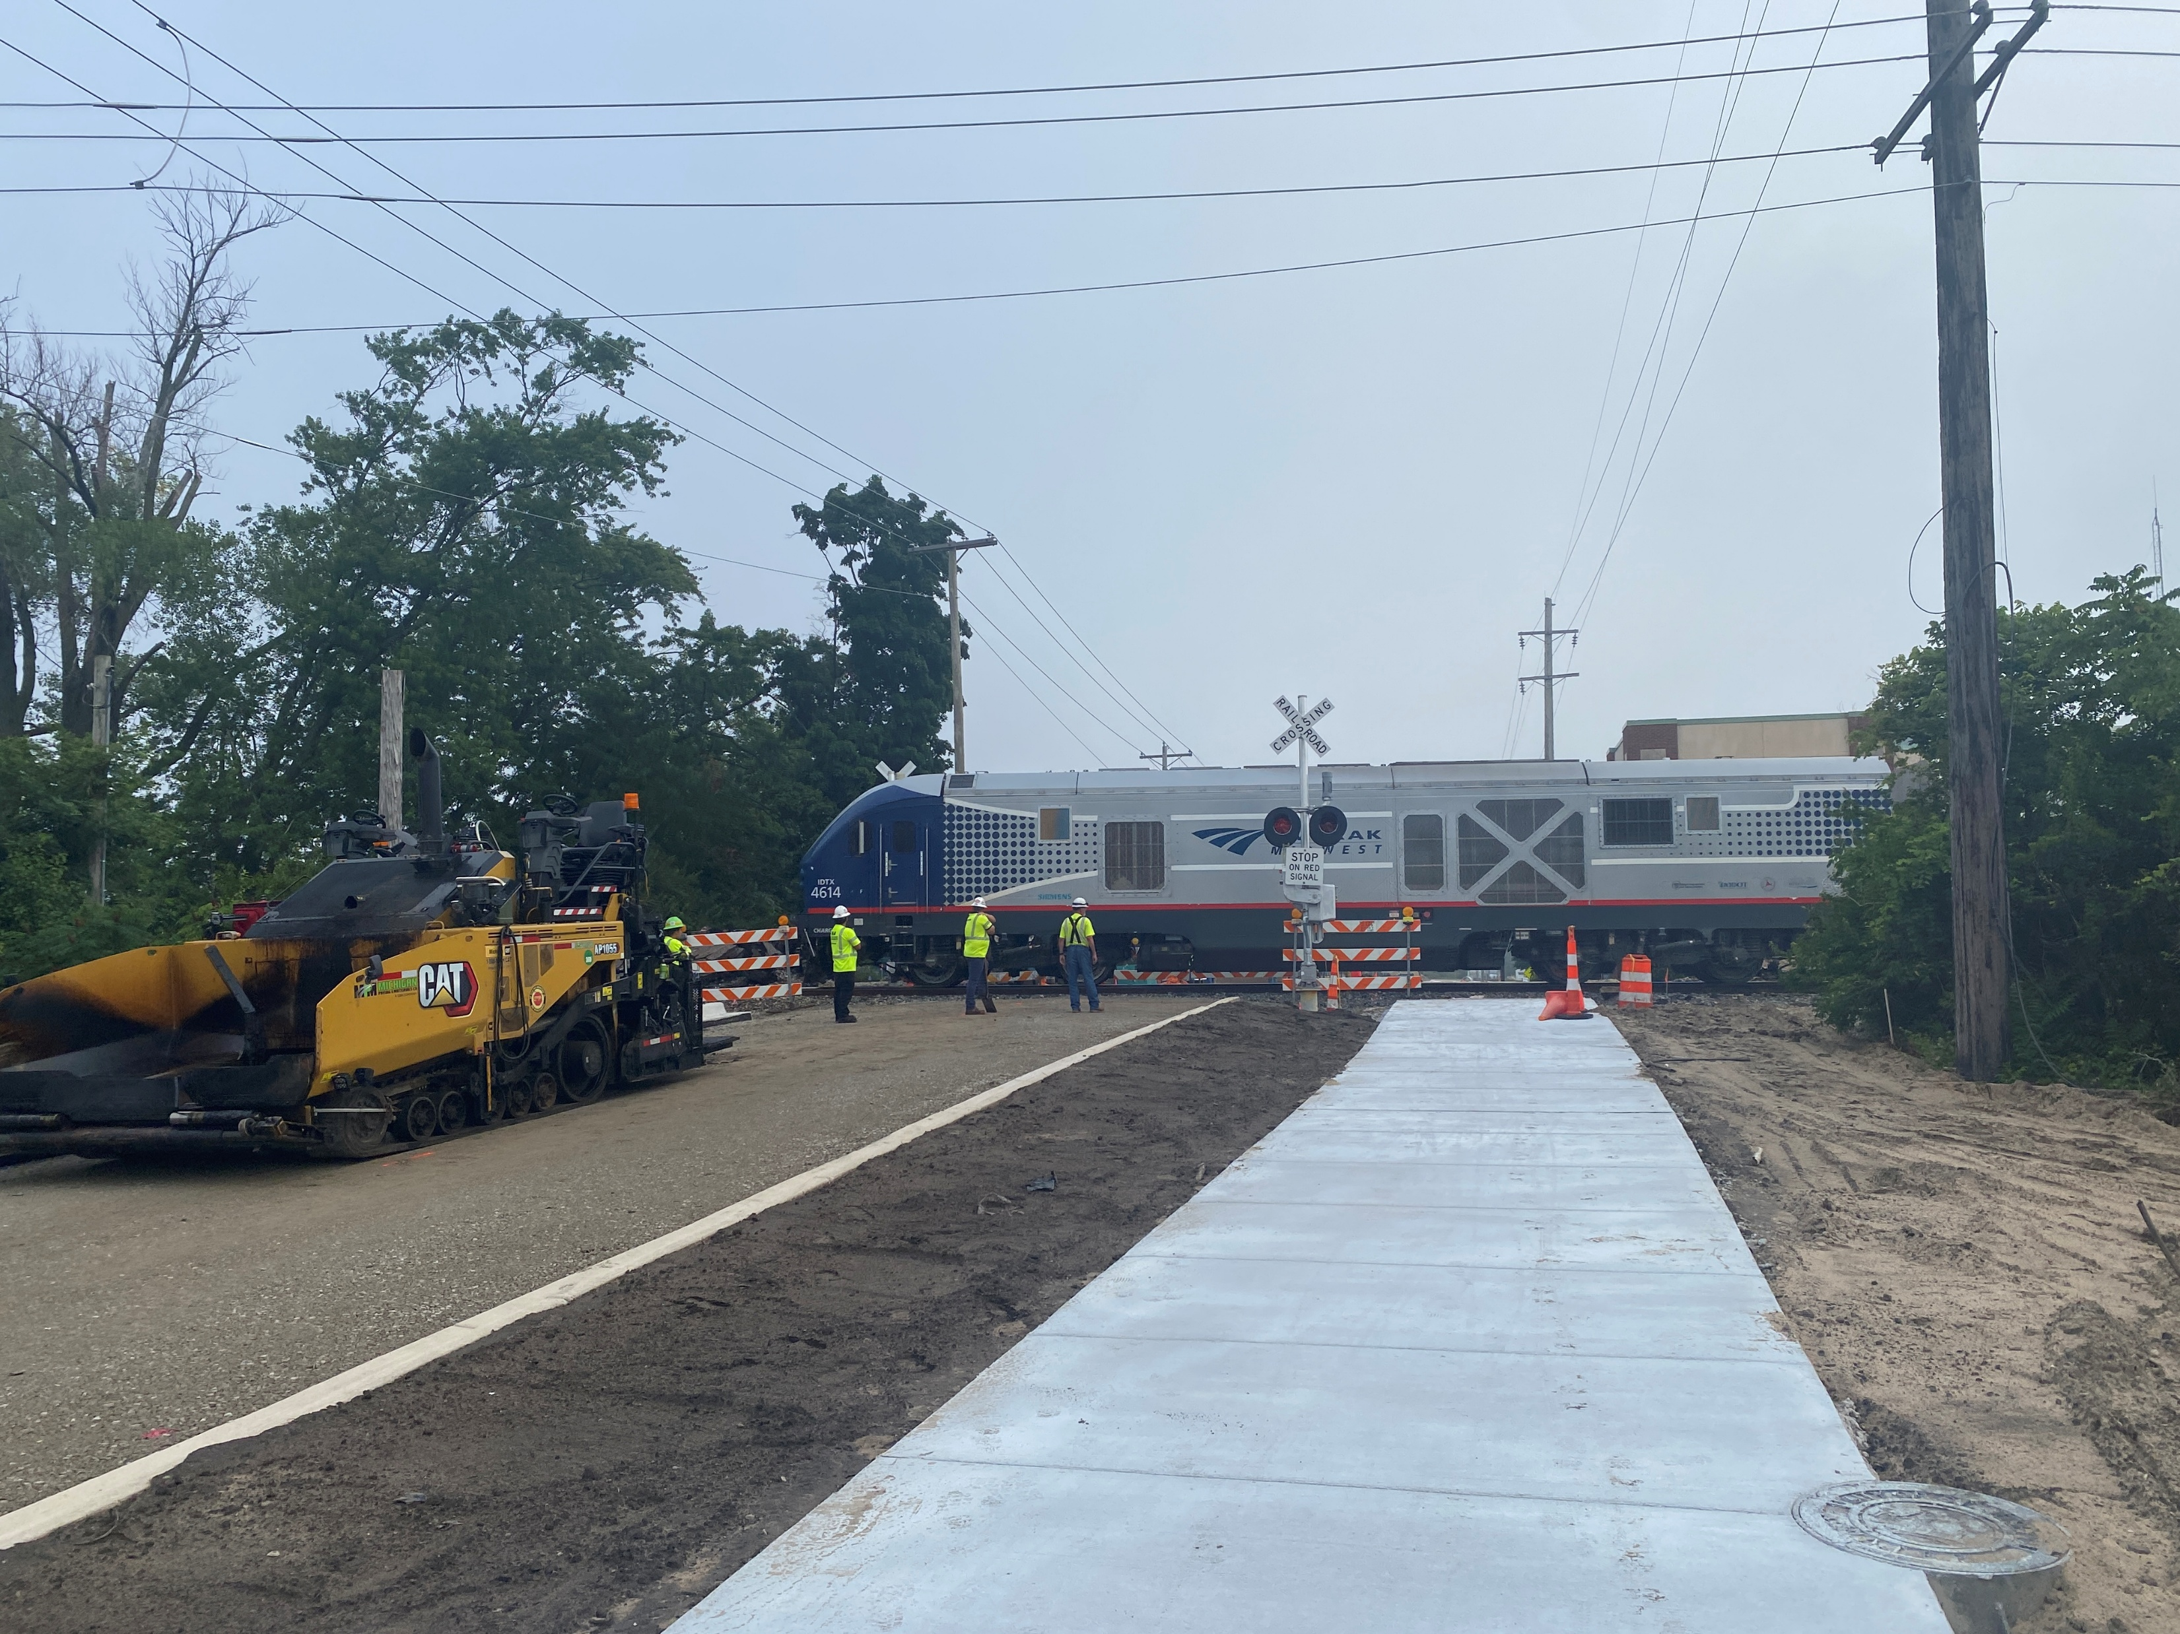
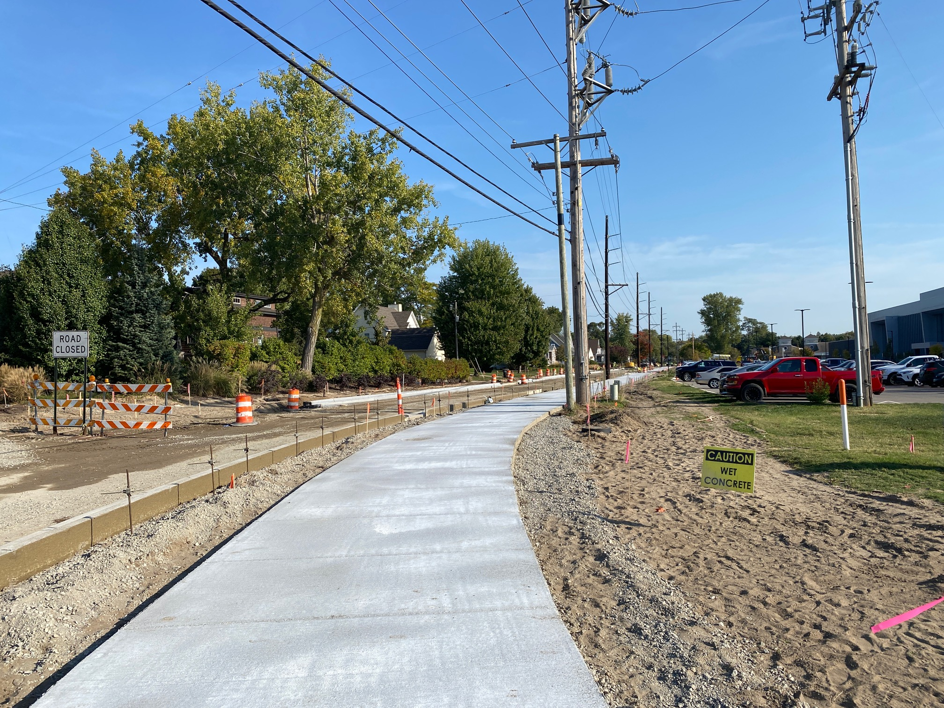
2028 Upton Drive Reconstruction Project
Non-Motorized Facilities Selection
Botham Avenue Reconstruction
Non-Motorized Facility Concept Selection
Examples of non-motorized
paths in the City
Howard Family Trail
Park Street
Upton Drive
Notes:
Here are a few more photos of the non-motorized paths on Park Street and Upton Drive south of Momany Drive.

Slide 7
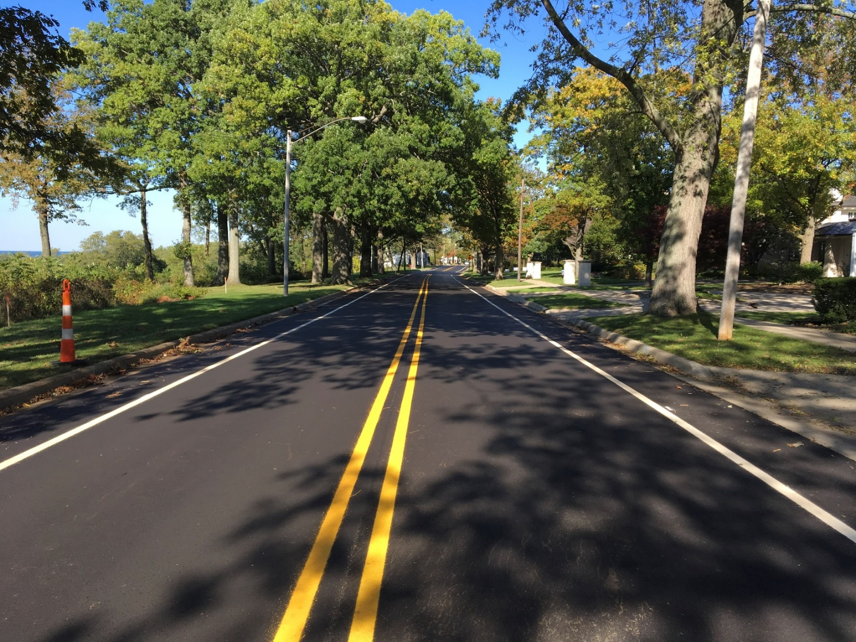
2028 Upton Drive Reconstruction Project
Non-Motorized Facilities Selection
Botham Avenue Reconstruction
Non-Motorized Facility Concept Selection
Example of bike lanes
in the City
Lake Blvd
Notes:
Here is an example of bike lanes on Lake Blvd.

Slide 8
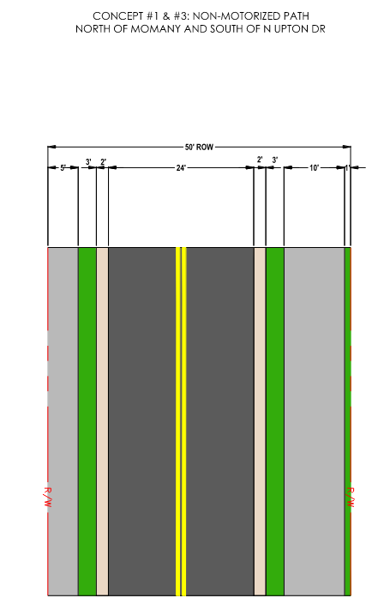
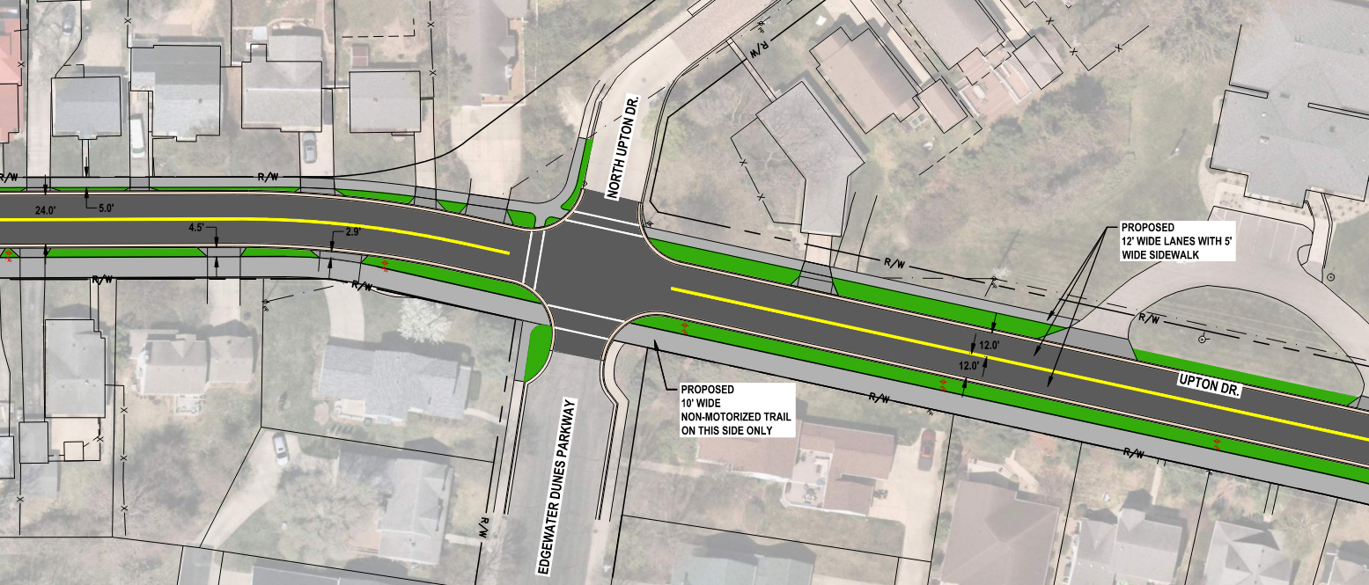
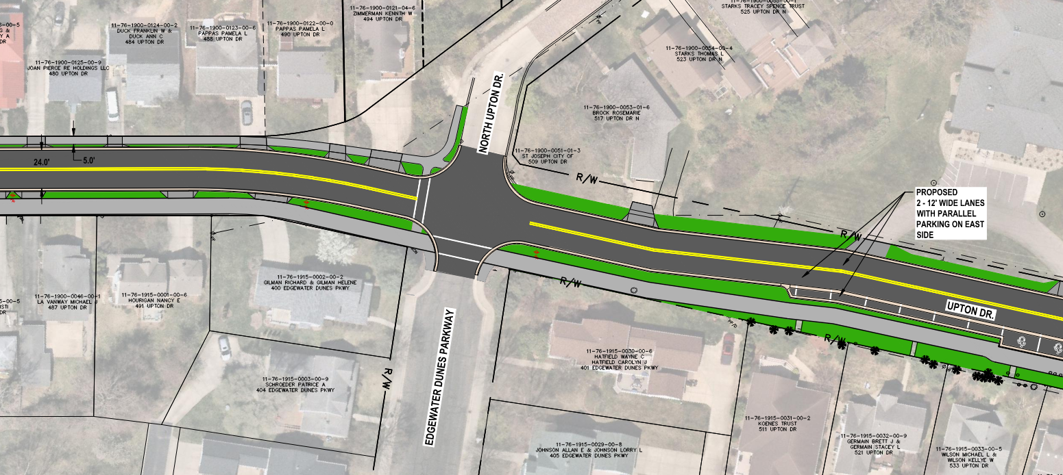
2028 Upton Drive Reconstruction Project
Non-Motorized Facilities Selection
Concept One
ROW to narrow to fit on-street parking & meet current design standards
Concept Three
Notes:
We initially offered two concepts:
Concept One included 2-12 foot-wide travel lanes, a 10-foot-wide non-motorized path, and eliminated on-street parking.
Concept Two included 2-12 foot-side travel lanes, 2-5 foot wide on-street bike lanes and eliminated on-street parking.
Concept Three was added when it was suggested to offset the roadway within the right of way north of Edgewater Parkway to allow space for on-street parking.
Concept Four was added more recently to offer bike lanes with on-street parking, also north of Edgewater Dunes Parkway.
The pavement section shown on the left shows how tight the space constraints are on Upton from Momany Drive to Edgewater Dunes Parkway.
Even if we eliminate non-motorized facilities, there isn’t enough space to safely allow on-street parking along this stretch of road based on the current design requirements associated with the STBG funding.

Slide 9
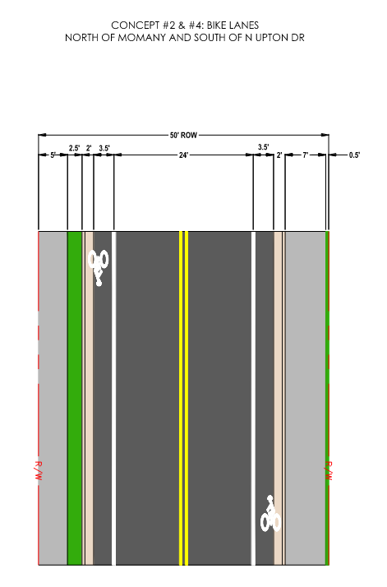
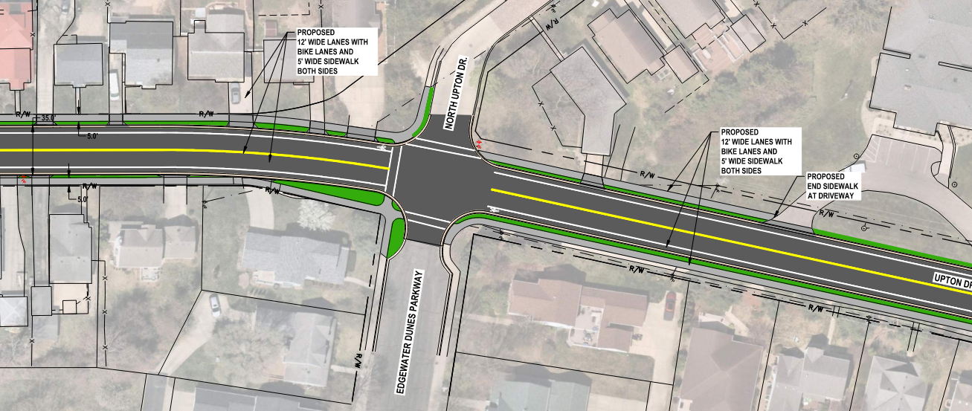
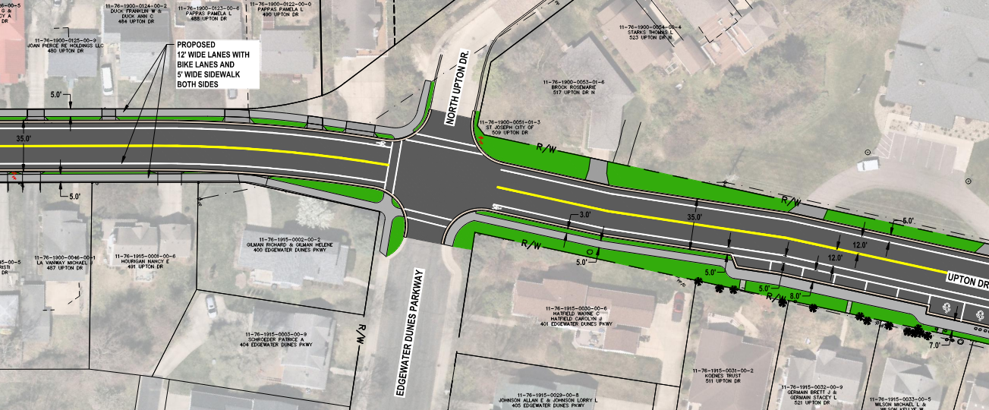
2028 Upton Drive Reconstruction Project
Non-Motorized Facilities Selection
Concept Two
Concept Four
Notes:
And this is concept two and four illustrating the bike lanes.

Slide 10
2028 Upton Drive Reconstruction Project
Non-Motorized Facilities Selection
 | Concept One Non-Motorized Path (NMP) | Concept Two Bike Lanes | Concept Three Non-Motorized Path (NMP) with On-Street Parking North of EW Dunes Parkway (east side only) | Concept Four Bike Lanes with On-Street Parking North of EW Dunes Pkwy (east side only)
Pros | Family Friendly. Matches existing non-motorized facilities (connects to NMP south of Momany Drive and north to M63). Narrowed roadway typically reduces vehicle speeds. More green space as compared to option 3. | Preferred by commuters. More green space as compared to option 4. | Family Friendly. Matches existing non-motorized facilities (connects to NMP south of Momany Drive and north to M63). Narrowed roadway typically reduces speeds. Mitigates the loss of on-street parking to a degree. Tapered alignment required to provide space for on-street parking typically reduces vehicle speeds. | Preferred by commuters. Mitigates the loss of on-street parking to a degree. Tapered alignment required to provide space for on-street parking typically reduces speeds.
Cons | Loss of On-Street Parking. May lead to enforcement workload if motorized use is an issue. | Loss of On-Street Parking. Increased roadway width typically increases speeds (as compared to options 1 and 3). Does not match adjacent non-motorized paths. Inexperienced cyclists share a 5-foot sidewalk with pedestrians. | Less green space as compared to Concept 1 May lead to enforcement workload if motorized use is an issue (golf carts). | Less green space as compared to Concept 2. Increased roadway width typically increases speeds (as compared to options 1 and 3). Does not match adjacent non-motorized paths. Inexperienced cyclists share a 5-foot sidewalk with pedestrians. Car doors open into northbound bike lane.
Notes:
This is a list of the pros and cons of each of the concepts.
I will skip to 3 and 4 because there was a strong preference for on-street parking, eliminating concepts 1 and 2 from consideration.
Read the concepts.

Slide 11
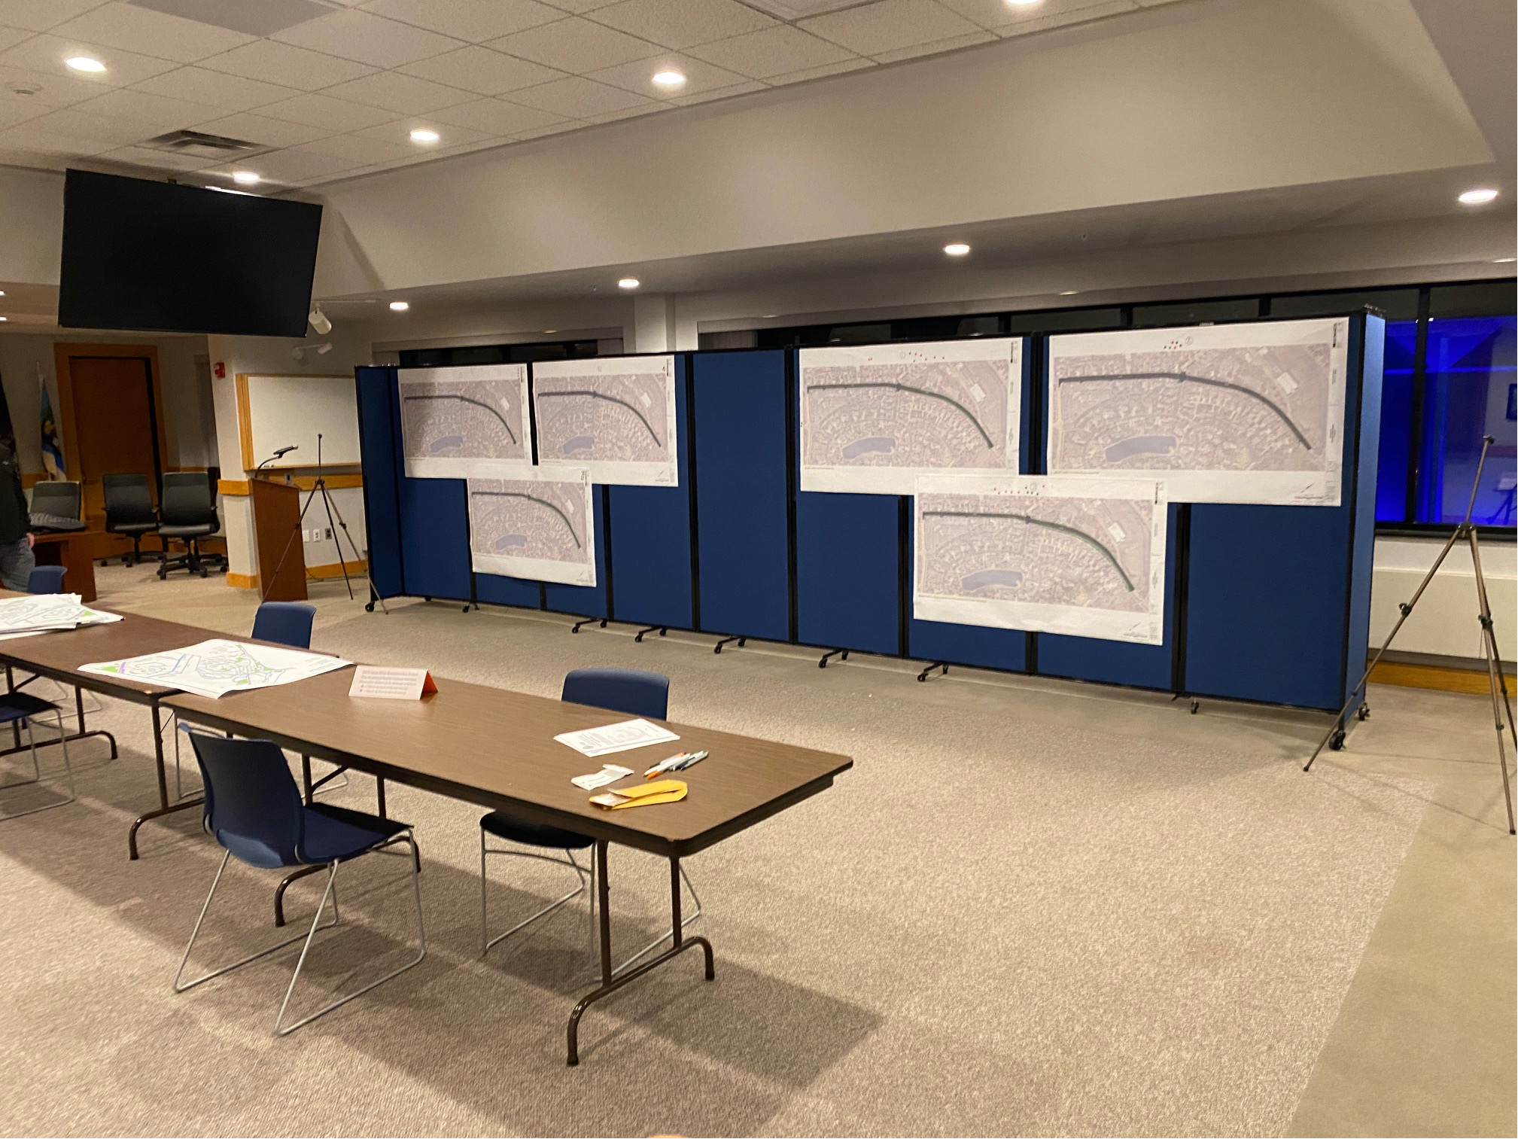
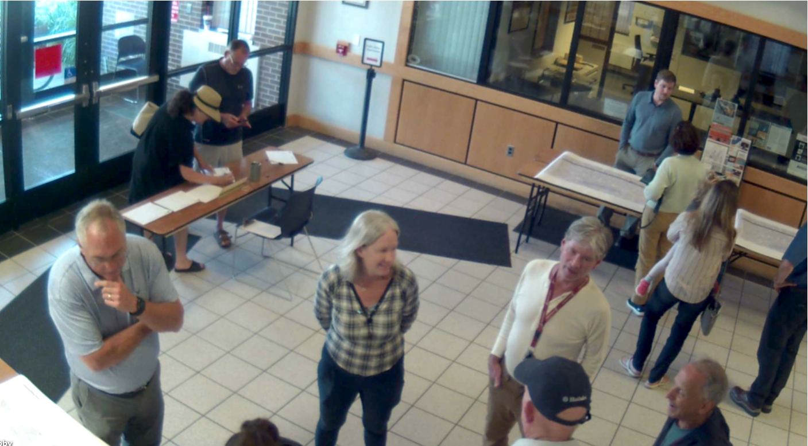
2028 Upton Drive Reconstruction Project
Non-Motorized Facilities Selection
Public Input Process
1st Open House: November 12, 2025 21 attendees signed in
2nd Open House: June 23, 2026 20 attendees signed in
Good participation from the public
Concerns raised:
Tree removals/Landscaping Impacts –work will remain in the right-of-way
Underground Electric – contacted AEP – provided rough estimate $3.7 million
Suggestions that we considered:
Added Parking by shifting road north of EW Dunes Parkway/N Upton Drive
Golf Carts
E Bikes
Notes:
The City received a high volume of thoughtful comments by email and at the Open House held on November 12, 2025, including questions that required gathering additional information and fieldwork.
The time between the 1st and 2nd Open Houses gave us time to gather information from AEP and fill in some of the survey gaps that they had not collected.
Read the slide.
Golf carts – we will add bollards at strategic locations.
E Bikes – A policy is already in work by Public Safety Director Neubecker and City Attorney Schmidt.

Slide 12
2028 Upton Drive Reconstruction Project
Non-Motorized Facilities Selection
1st Public Input Process
Email Input
1 NMP | 2 Bike Lanes | 3 NMP & Parking
5 | 5 | 1
1st Open House*
 | 1 NMP | 2 Bike Lanes | 3 NMP & Parking
Green Sticker | 3 | 5 | 12
Red Sticker | 12 | 4 | 6
* Not included in combined public input below, of the 21 attendees, all but 3 provided written input during 1st and 2nd input process
2nd Public Input Process
1 NMP | 2 Bike Lanes | 3 NMP & Parking | 4 Bike Lanes & Parking
6 | 3 | 13 | 12
Combined Public Input Process by Concept**
 | Yes | No | Neutral
Parking | 22 | 10 | 4
NMP (1 & 3) | 21
Bike Lanes (2 & 4) | 18
** Removed duplicate "votes" and adjusted for change of preference.
Notes:
Read through the numbers.

Slide 13

2028 Upton Drive Reconstruction Project
Non-Motorized Facilities Selection
Summary and Recommendation
The majority of input favored adding parking.
In general
Residents fronting on the impacted section of Upton Drive desire bike lanes.
Public open house attendees made a concerted effort to understand the concepts to decide their preference, and communicated respectfully with the staff and Abonmarche.
Most communicated a strong preference for the concept they desired.
No clear preference for NMP versus bike lanes; therefore, the concept recommendation is based solely on technical aspects.
Either concept will work.
NMP is safer and recommended for the following predominant reasons:
  Consistent with existing non-motorized paths on both ends of the project.
  The narrower road width typically reduces vehicular speeds.
Notes:
Read the slide.

Slide 14
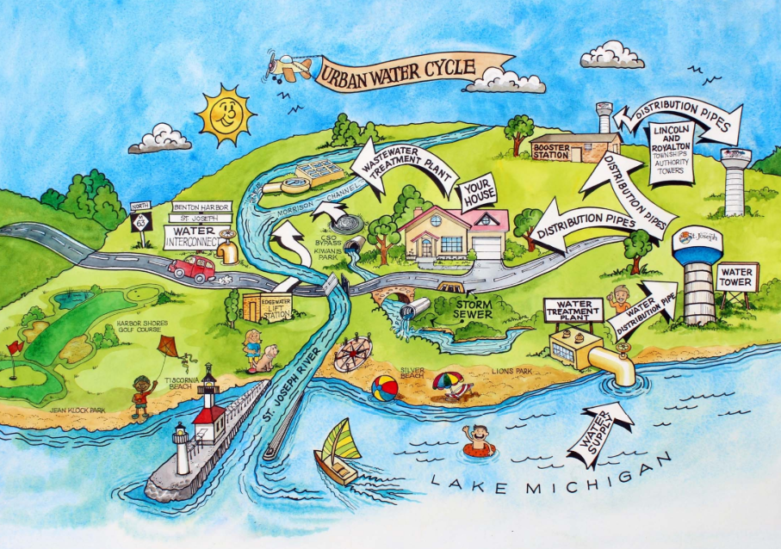
2028 Upton Drive Reconstruction Project
Non-Motorized Facilities Selection
Supplemental Slides

Slide 15
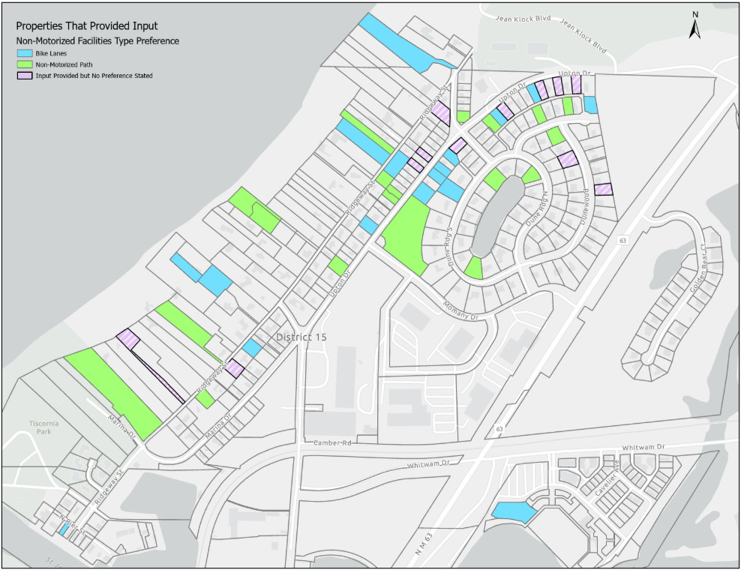
2028 Upton Drive Reconstruction Project
Non-Motorized Facilities Selection

Slide 16
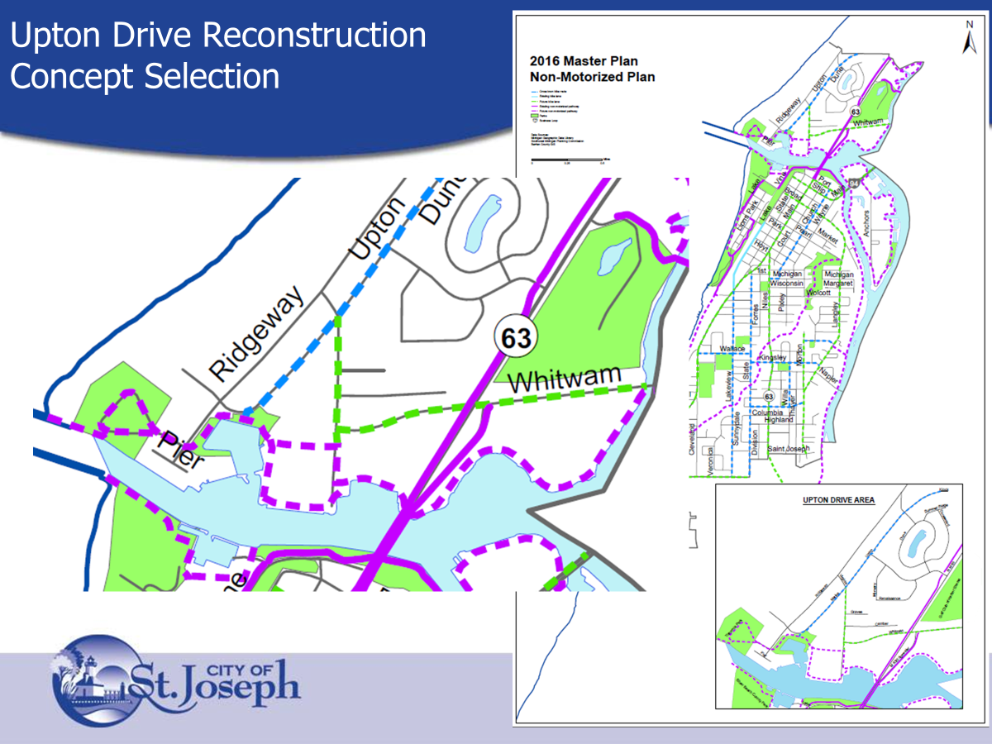
2028 Upton Drive Reconstruction Project
Non-Motorized Facilities Selection

